Slide 1

Gym Fitness Website

Slide 2

Team Details :-
Group Number :- 20
Team Members :-
Gaurav Kumar (CSBS 51)
Kumar Aayush (CSBS 18)

Slide 3

Introduction
The Gym Management System Project is a comprehensive web-based application designed to efficiently manage gym operations. Fitness enthusiasts use gyms as a space to build strength, increase endurance, enhance cardiovascular health, and maintain a healthy body composition. Additionally, gyms often offer group fitness classes and personal training services, which further contribute to people's fitness journeys. A gym management system is essential for fitness establishments as it streamlines operations, enhances member engagement, and ensures efficient equipment and staff management, ultimately contributing to a smoother and more effective fitness experience. It helps fitness centers maintain organization, offer better services, and track member progress, fostering a conducive environment for achieving fitness goals.

Slide 4

Features : -
Online registration of the member
Issuing the timetable of batch on system
Increase transparency between stakeholders
Easy payment options
Standardization of the system

Slide 5
Brief overview of the technology:
Front end: HTML, CSS, JavaScript
HTML: HTML is used to create and save web document. E.g. Notepad/Notepad++
CSS : (Cascading Style Sheets) Create attractive Layout
Bootstrap : responsive design mobile freindly site
JavaScript: it is a programming language, commonly use with web browsers.
Back end: PHP, MySQL
PHP: Hypertext Preprocessor (PHP) is a technology that allows software developers to create dynamically generated web pages, in HTML, XML, or other document types, as per client request. PHP is open source software.
MySQL: MySql is a database, widely used for accessing querying, updating, and managing data in databases.

Slide 6
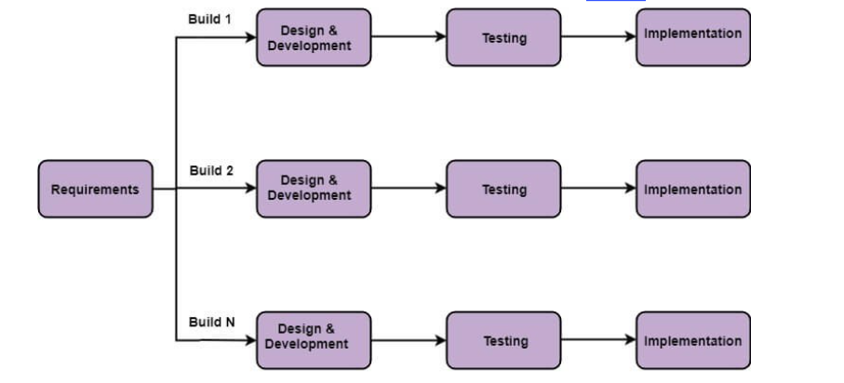
PROCESS MODEL
Incremental Model

Slide 7

Advantages
User can login and see the exercise from any part of the world.
It can be used by trainers too.
No need to travel for gym so it reduces time for you.

Slide 8
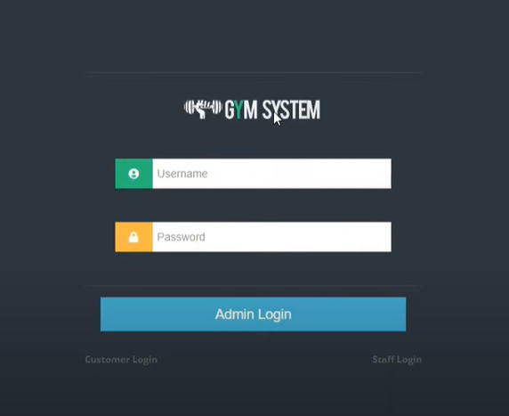
Screen Layouts
Login Screen

Slide 9
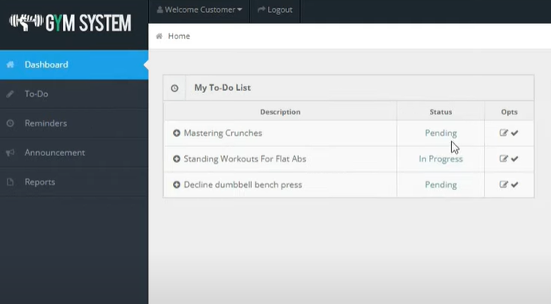
Screen Layouts
User Dashboard

Slide 10

Thank You

